Slide 1

LGBTQIA+ Awareness

Slide 2
You should have a better understanding of…
Meaning of LGBTQIA+
Common Questions/Concerns??
Understanding “SEX” vs. “GENDER”
Use of appropriate words when investigating incident
What to do if you misuse a pronoun
Mental Health concerns amongst LGBTQIA+
Ways to support the LGBTQIA+ community
Resources

Slide 3
What does LGBTQIA+ stand for?
L= Lesbian
G= Gay
B= Bisexual
T= Transgender
Q= Queer/ Questioning
I= Intersex
A= Asexual

Slide 4
Common Questions
Is this just for the training or do they actually use the LGBTQIA acronym out there. Do they refer to themselves as LGBTQIA? As a group of people?
Do you know if this percentage of LGBTQIA people that commit suicide are people that are out or not yet?
When someone is transitioning and going through their physical change at what point can they change their identity on their license and such?

Slide 5
Common Questions
What would be your recommendations on communicating empathy when it’s borderline between a hate crime and freedom of speech?
One thing that I come across on a regular basis is a man who is dressing as a woman. … How do I articulate this person in a simple and straightforward way while completing a report, radio transmission, etc?
Talking about searches, and dealing with strip searches. Policy states they have to have same gender, so this presents unique challenges for transgender individuals.

Slide 6
Sex vs Gender
A person's sex and gender are NOT the same thing!
Sex is the classification of a person as male or female.
This sex assignment at birth is typically based solely on one’s genitals.
Gender describes the internal experience of being a man, a woman, a nonbinary person, or otherwise. Every person experiences gender differently and you cannot know someone’s gender by simply looking at them.
*The Trevor Project

Slide 7
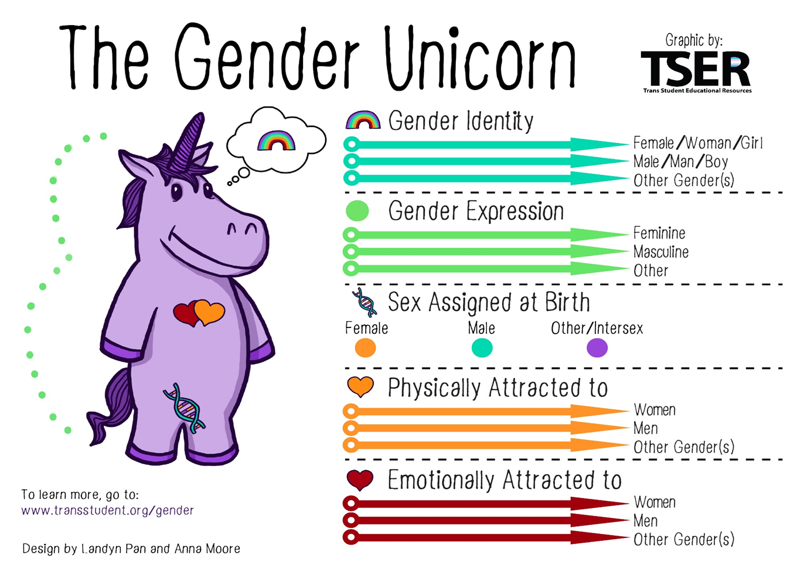
*Equitas Health

Slide 8
Common Genders
Cisgender: people whose gender identity aligns with the sex they were assigned at birth.
Transgender: people whose gender identity differs from the sex they were assigned at birth. Some folks might choose to receive certain gender affirming care but this is not necessary and each person should be allowed to choose what works best for themselves.
Nonbinary: an umbrella term to describe people who experience their gender identity and/or expression outside of the male/female/ man/woman binary, including folks who are genderfluid, genderqueer, polygender, bigender, demigender, agender, and many others.
*The Trevor Project

Slide 9
How to be Respectful
Using preferred names- shows acceptance and support
Using correct pronouns (she/her, he/him, they/them)
Avoid assumptions- use gender neutral language when unsure
  Instead of Boyfriend/Girlfriend—- Use Partner/Significant Other
  Instead of Husband/Wife—- Use Spouse
  Instead of Boys/Girls—- Use Friends, Folks, Everyone, Kids
  Instead of Daughter/Son—- Use Child
  Instead of Brother/Sister—- Use Sibling
Most of the time people are understanding that mistakes happen. If you refer to someone as the wrong name or use the wrong pronoun, acknowledge your mistake and try your best to correct yourself in the future.
*The Trevor Project

Slide 10
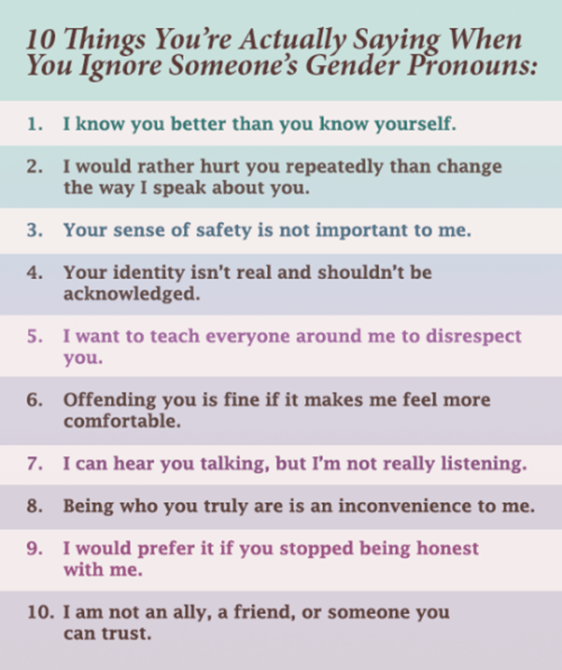

Why is it Important to Get Pronouns Right?
*Human Rights Campaign

Slide 11
Suicide Facts & Risk Factors
LGBTQ+ young people are more than four times as likely to attempt suicide than their peers (Johns et al., 2019; Johns et al., 2020).
The Trevor Project estimates that more than 1.8 million LGBTQ+ young people (ages 13-24) seriously consider suicide each year in the U.S. and at least one attempts suicide every 45 seconds.
Risk factors:
  Lack of support
  Physical harm/bullying
  Discrimination
*The Trevor Project

Slide 12
Mental Health Risk Factors
ANXIETY/DEPRESSION
Anxiety and Depression are the most reported clinical diagnosis's
67% of LGBTQ youth reported experiencing symptoms of anxiety (2022 74%)
54% of LGBTQ youth reported experiencing symptoms of depression (2022 58%)
The Trevor Project 2023

Slide 13
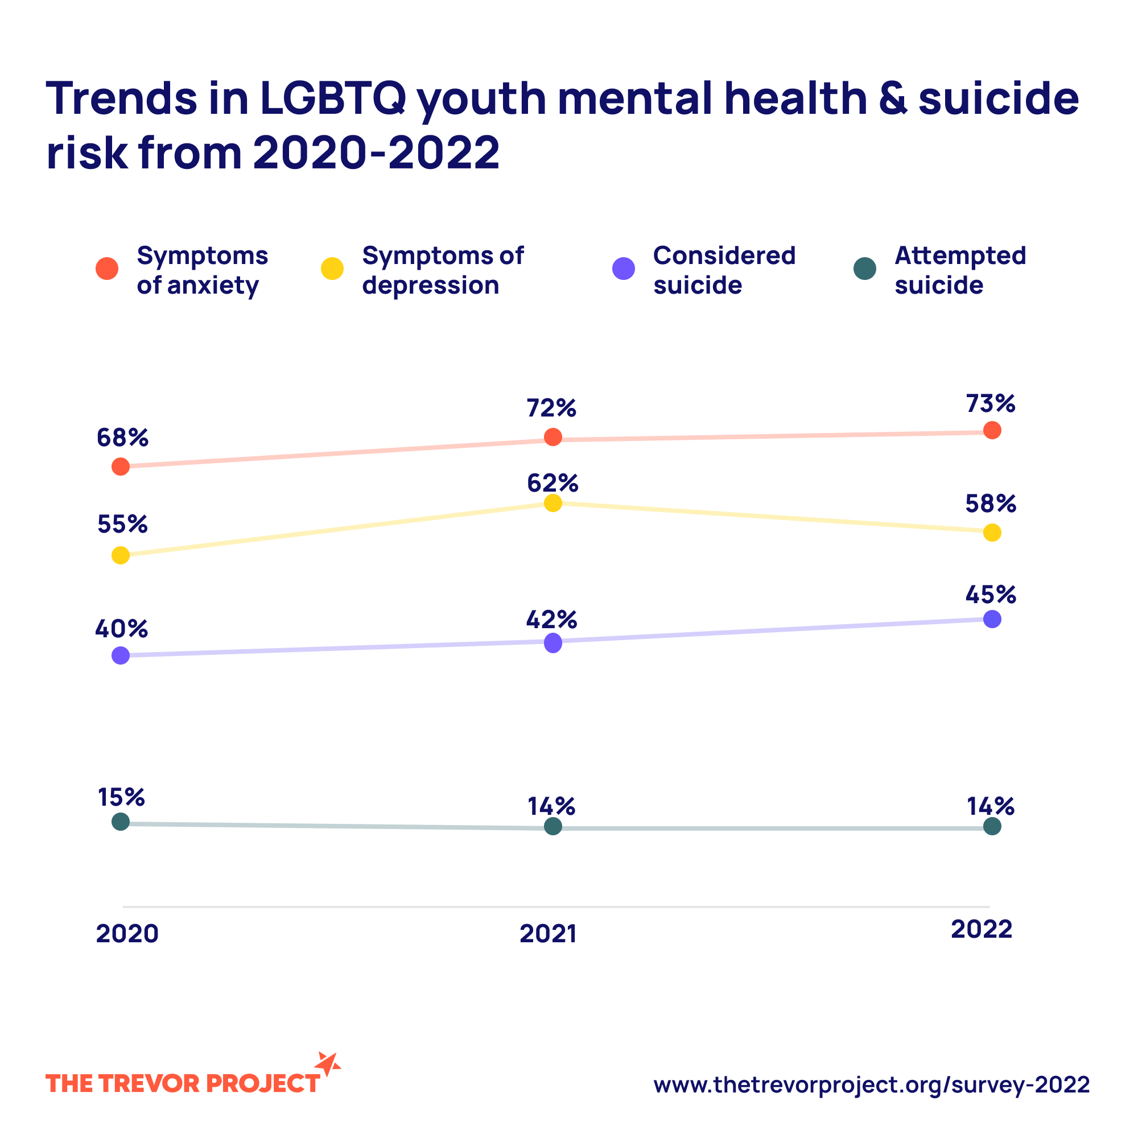
Mental Health Risk Factors

Slide 14
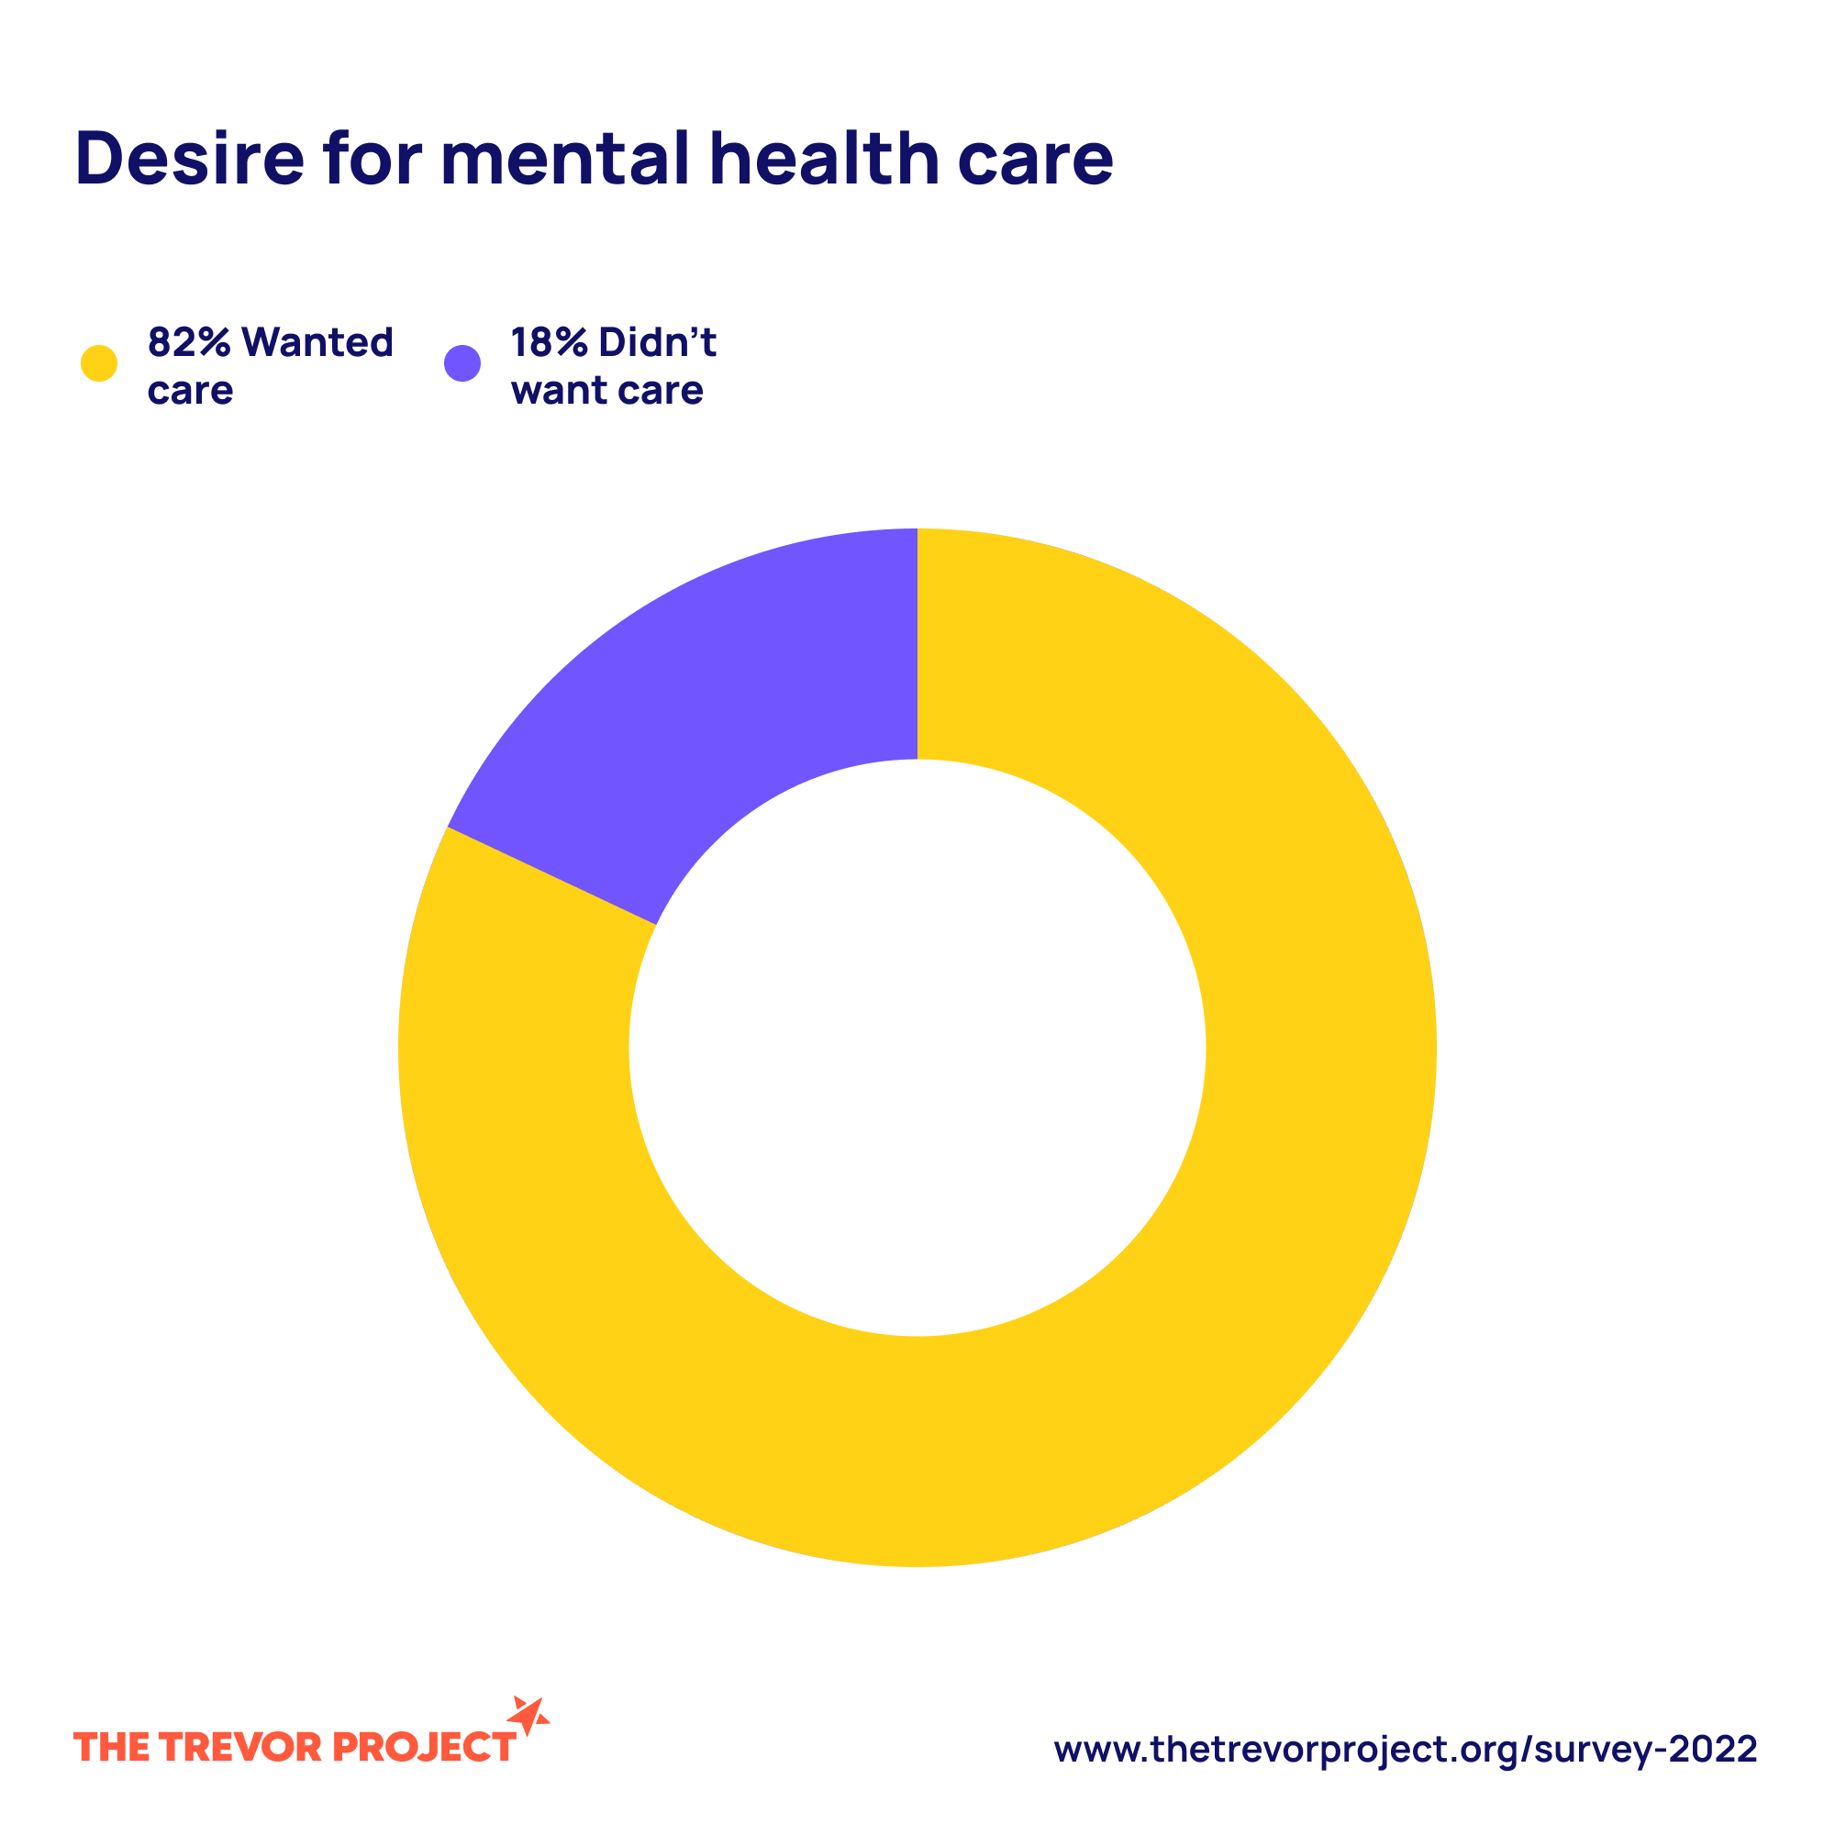
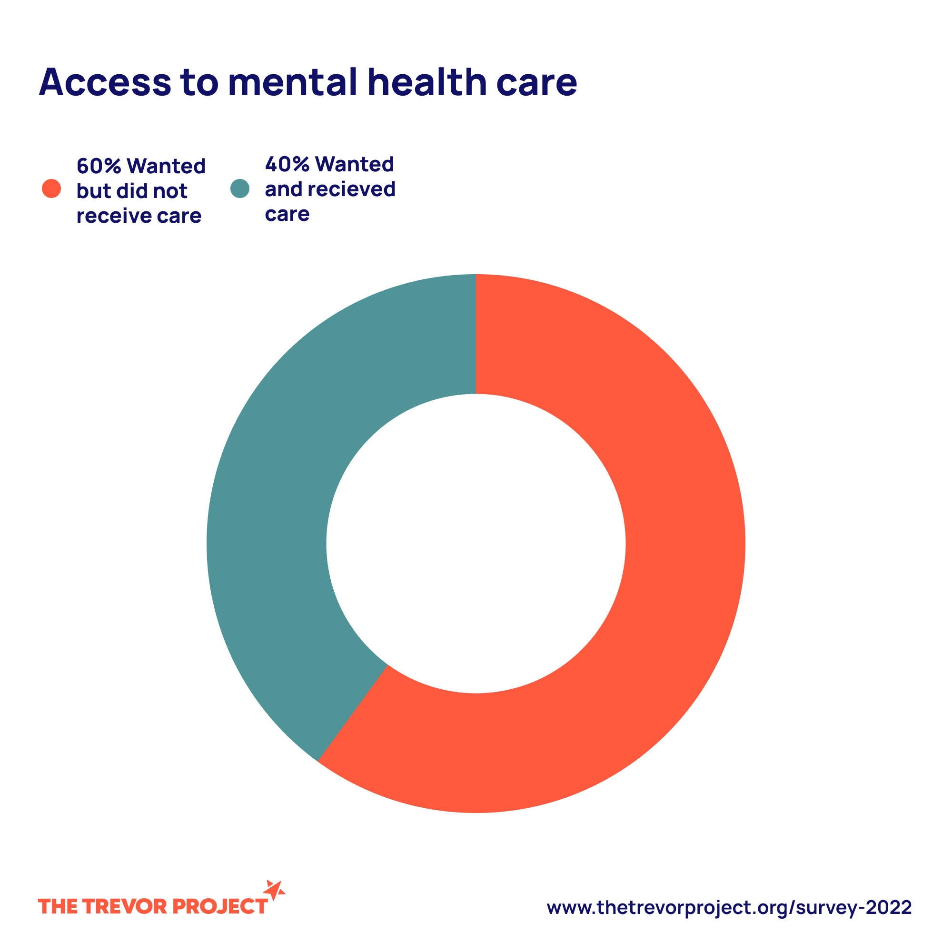
Mental Health Risk Factors

Slide 15
Mental Health Risk Factors
60% of LGBTQ youth reported that they have experienced discrimination based on their sexual orientation.(2022 65%)*
51% of transgender and non-binary youth reported that they have experienced discrimination based on their gender identity.(2022 61%)*
Youth and Adults higher risk with self medicating and later on addition (prescription, illicit drugs, alcohol)
*The Trevor Project 2023

Slide 16
Personal & Community Barriers
Lack of support (School, Work, Police, First Responders, Community, Peers, Parents/Gaurdians, legal system, laws).
Lack of/access to resources (Therapists, LBTGQIA+ Organisations, Support Groups)
24% of LGBTQ youth reported that they have been physically threatened or harmed due to either their sexual orientation or gender identity.*(2022 36%)
18% of LGBTQ youth reported that they have been physically threatened or harmed due to their sexual orientation.*(2022 31%)
27% of transgender and non-binary youth reported that they have been physically threatened or harmed due to their gender identity.*(2022 37%)
Stigma
*The Trevor Project 2023

Slide 17
5 Ways You Can Support The LGBTQIA+ Community
Listen- take the time to listen and learn from the LGBTQIA+ community.
Be a role model- don’t tolerate any kind of hateful speech, speak up for kindness and inclusion
Allow people to be authentic around you, be open and accepting of differences
Take action- know what resources you can offer, empower others to be understanding and empathetic
Stay informed- keep current on local and world events as well as laws/policies specific to this population
*Human Rights Campaign

Slide 18
Resources
www.thetrevorproject.org
www.nami.org
Youth
  Text Start 678-678
  Call 1-866-488-7386
National Suicide Prevention Line
  (800) 273-8255 (online chat available)
Crisis Text Line
  Text START to 741-741
Trans Lifeline
  (877) 565-8860

